Slide 1
Workplace Diversity
I think that God in creating MAN somewhat overestimated his ability
-Oscar Wilde

Slide 2

What is Workforce Diversity?
Refers to the similarities and differences among employees in an organization in such characteristics as age, gender, ethnic heritage, physical abilities and disabilities, race, and sexual orientation

Slide 3
What is Workforce Diversity? (continued)
Employees’ conceptions of work, expectations and rewards from the organization, and practices in relating to others are all influenced by diversity.
Managers of diverse work groups need to understand how the social environment affects employees’ beliefs about work, and they must have the communication skills to develop confidence and self-esteem in members of diverse work groups.
Managing diversity today – recruiting, training, valuing, maximizing potential of people

Slide 4
Valuing Diversity
Top managers value diversity
Give organization access to broader range of opinions and viewpoints
Reflect an increasingly diverse customer base
Obtain the best talent in a competitive environment
Demonstrate the company’s commitment to doing the right thing

Slide 5
The two major forms of workforce diversity
Surface-level diversity
Deep-level diversity
Diversity Management
Notes:
Everybody brings differences to an organization where they work. These differences can create energy and excitement in the workplace, but they can also cause conflict. So it is important that we have an understanding of how diversity works in organizations.
When we look at the workplace we can recognize two levels of diversity. Surface-level diversity represents the characteristics that are easily observed such as race, gender, age etc. Deep-level diversity represents the aspects that are more difficult to see at first glance such as values, personality, and work preferences.
Organizations need to engage in Diversity Management to eliminate unfair discrimination. By understanding what diversity is and helping employees with training and development opportunities, the negative impact of discrimination can be minimized.

Slide 6
The two major forms of workforce diversity
Everybody brings differences to an organization where they work. These differences can create energy and excitement in the workplace, but they can also cause conflict. So it is important that we have an understanding of how diversity works in organizations.
When we look at the workplace we can recognize two levels of diversity.
Surface-level diversity represents the characteristics that are easily observed such as race, gender, age ,tenure, religion, sexual orientation, and gender identity.
Age is an increasingly relevant characteristic as the workforce is aging. Older workers bring with them a wealth of knowledge and experience, but the perception is that productivity often declines with age.
In studying gender in the workplace, it has been found that there are very few differences between men and women that impact job performance. However, women, especially those with pre-school age children, do prefer flexible work schedules and will seek an employer who offers options in their schedules.

Slide 7
The two major forms of workforce diversity
Religion may also impact work outcomes due to religious restrictions, such as dress and grooming. Schedules may also conflict with the way work is typically done, such as a Muslim worker adhering to the prayer schedule outlined in Islam
Sexual Orientation and Gender Identity are handled differently by most employers. Often, these characteristics are dealt with just as if they were protected characteristics in order to discourage discriminatory behavior, whether it is covered by the law or not.
Race and Ethnicity offers little explanation for differentials in workplace outcomes. It has been shown, however, that people in the workplace do identify more with people like themselves so in some cases there may be opportunities given to people based on the fact that they are like their supervisor.
Tenure refers to the length of time people have been on the job and is tied to seniority. Often, tenure is seen as a positive as it signifies that people are happy with their employment because they have remained in their job for a long period of time. Therefore, employees with long tenure tend to be more productive, call in sick less frequently, and don’t leave the organization as readily

Slide 8
The two major forms of workforce diversity
Deep-level diversity represents the aspects that are more difficult to see at first glance such as values, personality, and work preferences.
Organizations need to engage in Diversity Management to eliminate unfair discrimination. By understanding what diversity is and helping employees with training and development opportunities, the negative impact of discrimination can be minimized.

Slide 9
Role of Disabilities
When focusing on ability, it can create problems when attempting to develop workplace policies that recognize diversity in terms of disabilities.
It is important to recognize diversity and strive for it in the hiring process.
An organization needs to be careful to avoid discriminatory practices by making generalizations about people with disabilities.
Notes:
When an organization discusses abilities, it can cause difficulty when developing policies that recognize diversity in terms of disabilities. While it is important for the organization to strive for diversity in the hiring process, it is important to be careful to avoid discriminatory practices during hiring by making generalizations about people with disabilities.

Slide 10
Inclusive Practices in the Workplace
Building a corporate culture that values diversity
Changing structures, policies, and systems to support diversity
Recruitment
Career advancement
Providing diversity awareness training

Slide 11
Discrimination
Effective Diversity Management also helps to eliminate unfair discrimination.
Discrimination is to note a difference between things, which may not be necessarily bad ( especially in identifying an employee being more qualified in hiring decisions or another taking on leadership responsibilities exceptionally well for promotion decisions.
In other words, discrimination is allowing behavior to be influenced by stereotypes about groups of people.( rather than looking at individual characteristics)

Slide 12
Type of Discrimination | Definition | Examples from Org
Discriminatory Policies or practices | Actions by representatives of the organization that deny equal opportunity to perform or unequal rewards for performance | Older workers may be targeted for layoffs (highly paid and have lucrative benefits)
Sexual Harassment | Unwanted sexual advances/ verbal or physical conduct of sexual nature that creates an offensive, hostile environment | Company Indiscretions
Intimidation | Overt threats/ bullying ( directed at specific groups) | Minorities have to face negative situations
Mockery & Insults | Jokes or negative stereotypes | Negative, lewd comments
Exclusion | Being excluded from job opportunities, social events, discussions, informal mentoring | Women in the field of Finance feel marginalized
Incivility | Disrespectful treatment, behaving aggressively, interrupting and ignoring his/ her opinions | Female lawyers note that male attorneys frequently cut them off and do not address their comments

Slide 13
Implementing Diversity Management Strategies
Making everybody more aware and sensitive to the needs of others.
Attracting, Selecting, Developing, and Retaining the Diverse Employees
Working with Diversity in Groups
Effective Diversity Programs
Notes:
Knowing that people are different is not enough for organizations to operate effectively with differences. Managers must work to develop strategies to develop ways to utilize differences to achieve work outcomes. Managers start by attracting, selecting, developing, and retaining employees who can operate and excel in a workplace with diverse individuals, viewpoints, and ideas. Gaining a diverse workforce through the selection process and developing that workforce through organizational training and development programs will help to provide for an environment that fosters creativity and effectiveness by tapping into the potential of all employees.
More and more organizations are requiring employees to work in groups. Diversity can aid in group effectiveness and it can diminish it. Organizations must provide the tools to leverage the differences to obtain superior performance.
Effective workforce programs that encourage diversity contain three components. First, they teach managers about the laws they need to follow and equal employment opportunity requirements. Second, they help managers and employees to see that a diverse workforce is better able to serve diverse markets. Third, they take into account personal differences and approach the differences as strengths that can be utilized to enhance performance.

Slide 14
Implementing Diversity Management Strategies
Managers must work to develop strategies to develop ways to utilize differences to achieve work outcomes.
Managers start by attracting, selecting, developing, and retaining employees who can operate and excel in a workplace with diverse individuals, viewpoints, and ideas. Gaining a diverse workforce through the selection process and developing that workforce through organizational training and development programs will help to provide for an environment that fosters creativity and effectiveness by tapping into the potential of all employees.
More and more organizations are requiring employees to work in groups. Diversity can aid in group effectiveness and it can diminish it. Organizations must provide the tools to leverage the differences to obtain superior performance.

Slide 15
Implementing Diversity Management Strategies
Effective workforce programs that encourage diversity contain three components.
First, they teach managers about the laws they need to follow and equal employment opportunity requirements.
Second, they help managers and employees to see that a diverse workforce is better able to serve diverse markets.
Third, they take into account personal differences and approach the differences as strengths that can be utilized to enhance performance.

Slide 16
Diversity Initiatives
Recruitment
Examine employee demographics
Examine composition of the labor pool in the area
Examine composition of the customer base
Career Advancement
Eliminate the glass ceiling
Accomplish mentoring relationships
Accommodating Special Needs
Child care
Non-English speaking training materials and information packets can be provided
Maternity or paternity leave
Flexible work schedules
Home-based employment
Long-term-care insurance, special health or life benefits

Slide 17
Stages of Diversity Awareness
Highest Level of Awareness
Integration
Multicultural attitude-enables one to integrate differences and adapt both cognitively and behaviorally
Adaptation
Able to shift from one cultural perspective to another
Able to empathize with those of other cultures
Acceptance
Accepts behavioral differences and underlying differences in values
Recognizes validity of other ways of thinking and perceiving the world
Minimizing Differences
Hides or trivializes cultural differences
Focuses on similarities among all peoples
Defense
Perceives threat against one’s comfortable worldview
Uses negative stereotyping
Assumes own culture superior
Denial
Parochial view of the world
No awareness of cultural differences
In extreme cases, may claim other cultures are subhuman
Lowest Level of Awareness

Slide 18
Affirmative Action vs. Diversity Management
Affirmative Action
Diversity Management
Purpose
Prevent and remedy discrimination
Create an inclusive, empowered work environment
Assimilation
Assumes individuals will assimilate and adapt
Assumes that managers and the organizations will change
Focus
Recruitment, mobility, and retention
Allows all associates to reach their full potential
Cause of Problems
Does not address the cause of problems
Attempts to uncover the root causes of diversity problems
Time Frame
Temporary, until representation of disadvantaged groups
Ongoing, permanent changes
Adapted from Exhibit 2-1: Differences between Affirmative Action Programs and Diversity Management Programs

Slide 19

Forces of Change
Changing workforce demographics – percentage by race, age and sex
Increase in the service economy: Service jobs will increase by 17% between 2004 and 2014 and by 2014 will make up 78% of all jobs
Global economy: imports still outpacing exports, increase in the number of working relationships with other countries
Requirements for teamwork: one way to provide better goods and services, requires individuals to work well together
Notes:
Service jobs will increase by 17% between 2004 and 2014 and by 2014 will make up 78% of all jobs
Global – imports still outpacing exports, increase in the number of working relationships with other countries
Teamwork – one way to provide better goods and services, requires individuals to work well together.

Slide 20
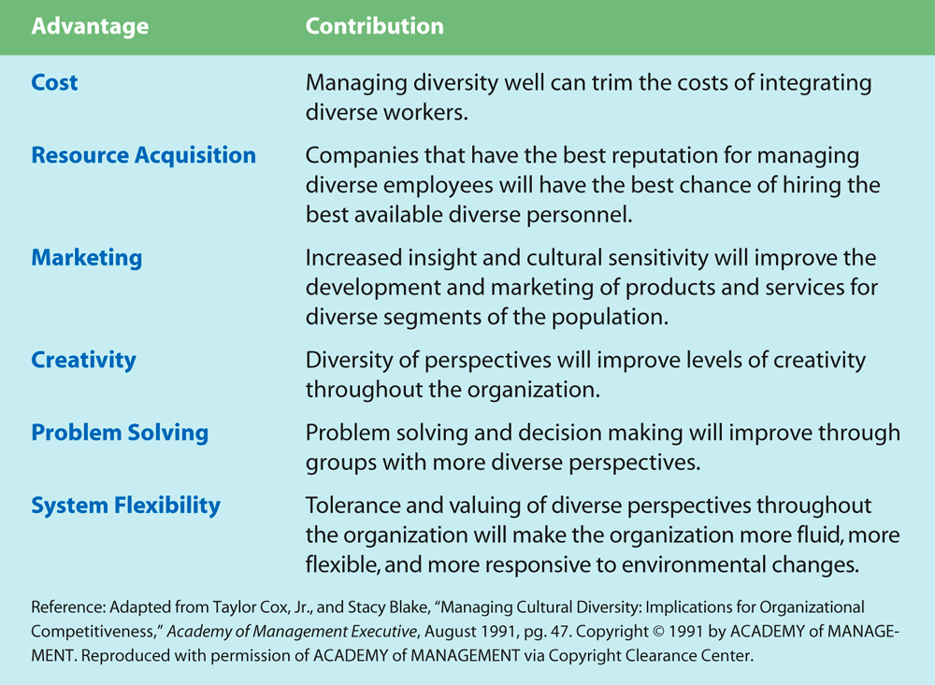
Six Ways Managing Diversity Can Create Competitive Advantage

Slide 21
Diversity’s Benefits & Problems
0
BENEFITS
PROBLEMS
Attracts & retains the best human talent
Improves marketing efforts
Promotes creativity and innovation
Results in better problem solving
Enhances organizational flexibility
Resistance to change
Lack of cohesiveness
Communication problems
Interpersonal conflicts
Slowed decision making

Slide 22
Roadblocks to Diversity
Stereotypes-A generalized set of beliefs about the characteristics of a group of individuals. A result of diversity is stereotyping where one assumes that group averages or tendencies are true for each and every member of that group. One must keep in mind the distinction between the sources of diversity and diversity itself or you will be likely to stereotype. Although employees are diverse, a relatively small amount of this diversity is explained by their group membership
Prejudice – Unfair negative attitudes we hold about people who belong to social or cultural groups other than our own
Discrimination – Behavior that results in unequal treatment of individuals based on group membership
Modern racism – Subtle forms of discrimination that occur because people know that it is wrong to be prejudiced against other racial groups and believe themselves not to be racists

Slide 23
The Workplace & Bias
Lack of choice assignments
Disregard by a subordinate of a minority manager’s direction
Ignoring of comments made by women & minorities at meetings
A need to become “Bicultural”

Slide 24
Leveraging Diversity: Creating the Multicultural Organization
Pluralism
A pluralistic organization has mixed membership and takes steps to fully involve all people who differ from the dominant group.
Full Structural Integration
Occurs when an organization has minority group members serving at all levels, performing all functions, and participating in all work groups.
Integration of Informal Networks
Fostered through mentoring programs, special social events, and support groups for minorities.

Slide 25

Creating the Multicultural Organization (continued)
Absence of Prejudice and Discrimination
Facilitated through equal opportunity seminars, in-house focus groups, and bias reduction training.
Equal Identification With Goals
When members of different groups participate fully in determining the organization’s direction and how to meet its goals, they better understand the organization and their place within it.

Slide 26
Commitment of Leaders
Communicate through multiple channels
Personally lead all diversity efforts
Sponsor employee councils
Ensure cross-cultural communication
Be accountable for advancing diversity initiatives
Notes:
High-ranking leaders send relevant communications through multiple channels, such as intranet postings, policy statements, formal newsletters, meetings, speeches, and training programs.
One high-ranking leader personally leads all diversity efforts. He or she holds town meetings and eats lunch in the cafeteria to talk about diversity.
Multiple high-ranking executives sponsor employee councils devoted to fostering cross-cultural communication. The councils are all-inclusive – anyone who wants to join can do so. Therefore, anyone can “have the ears” of executives on diversity issues.
Managers at all levels are held accountable for advancing diversity issues.

Slide 27
Diversity in a Turbulent World
Organizations that value diversity encourage and support network groups to enable minority organization members to
reduce their social isolation
be more effective in their jobs
have a greater impact on the organization
achieve greater opportunities for career advancement

Slide 28
The Generational Workforce
The Silent Generation / Traditionalists( 1900-1945 )
Duty and loyalty (They are the last generation to likely spend an entire career at one company)
Self-reliant and pragmatic
Struggle with technology
Most engaged generation and want opportunities to develop and learn.
They like teamwork.
They expect experience to be respected.

Slide 29
The Generational Workforce
Baby Boomers (1946-1964)
Associate self-worth with career (seen as “workaholics” who are driven by material acquisitions, titles and personal success)
Optimistic outlook and Youth orientation ( allowed them to embrace the latest technology)
Direct person-to-person communication
Team-oriented.

Slide 30
The Generational Workforce
Generation X (1965-1980)
Independent and self-directed
Skepticism toward authority.
Adaptable, focused on results and motivated by a need for security.
Rather work alone.
They are technologically literate.

Slide 31
The Generational Workforce
Millennials (1981-2000)
Internet usage and information technology knowledge from a very young age.
Confident (and sometimes over confident) due to highly involved, affirming parents.
They expect lots of feedback and rewards in the workplace
Considered to be idealistic.
They work to live, not live to work.
Work/life balance is more important to them than salary and they want to do work that improves society, putting emphasis on corporate social responsibility, sustainability and diversity.
They crave more frequent learning and advancement opportunities.
They are technology experts.

Slide 32
The Generational Workforce
Nexters/ Generation Z (born after 2000)
Digital natives
Shorter attention spans and limited interpersonal skills.
Creative – especially with respect to application of technology – and open-minded with a desire for opportunities to use their many skills
They expect feedback and rewards
Not principally motivated by money but by a flexible lifestyle.
Strong commitments to social responsibility.
Though immersed in technology, they prefer face-to-face communications.
They enjoy working in structured, small teams

Slide 33
The Changing demographics
The Silent Generation (born 1900-1945) currently makes up only about 3 percent of the global work force
Millennials (1981-2000) are now the most prevalent generation in the workplace (25 percent), surpassing the number of Baby Boomers (1946-1964) in 2014, and Generation X (1965-1980) in 2015
Millennials are on track to comprise 50 percent of the workforce worldwide by 2020.
“Nexters” or Generation Z (born after 2000) composed another 3 percent of the global workforce, but they make up more of the global population (25 percent) than any other generation. By 2020, they will be out of school, making up 20 percent of the global workforce right behind Millennials.
Source: www.navex global.com

Slide 34
MCQ(s)
1 Which of the following is not the way to manage diversity?
a. By recruiting
b. By training
c. By maximizing potential of people
d. All are the ways
2. Which of the following is not the stage of Diversity Awareness?
a. Denial
b. Acceptance
c. Defense
d. Affirmation

Slide 35
3. Which of the following is the roadblock to Diversity?
a. Stereotypes
b. Prejudice
c. Modern Racism
d. All the options
4. There are _____ major forms of workforce diversity
a. Two
b. Three
c. Four
d. Five

Slide 36
5. Which of the following is the not the advantage of Managing diversity?
a. Attracts & retains the best human talent
b. Promotes creativity and innovation
c. Slowed decision making
d. Results in better problem solving

